Slide 1


Pokémon Database Management System
Team Members:
Michal Salabura Bernard Joyce Nikita Smiichyk Hanna Bokariuk Oliver Halpenny

Slide 2
Project Overview
Database application developed using MySQL + Java JDBC
Models core elements of the Pokémon world:
Trainers, Pokémon, Types
Gyms, Regions, Towns
Battle logic & stats
Supports data analysis and gameplay-based decisions
Fully normalised database with advanced SQL features (triggers, views, procedures)
Java application to interact with database

Slide 3
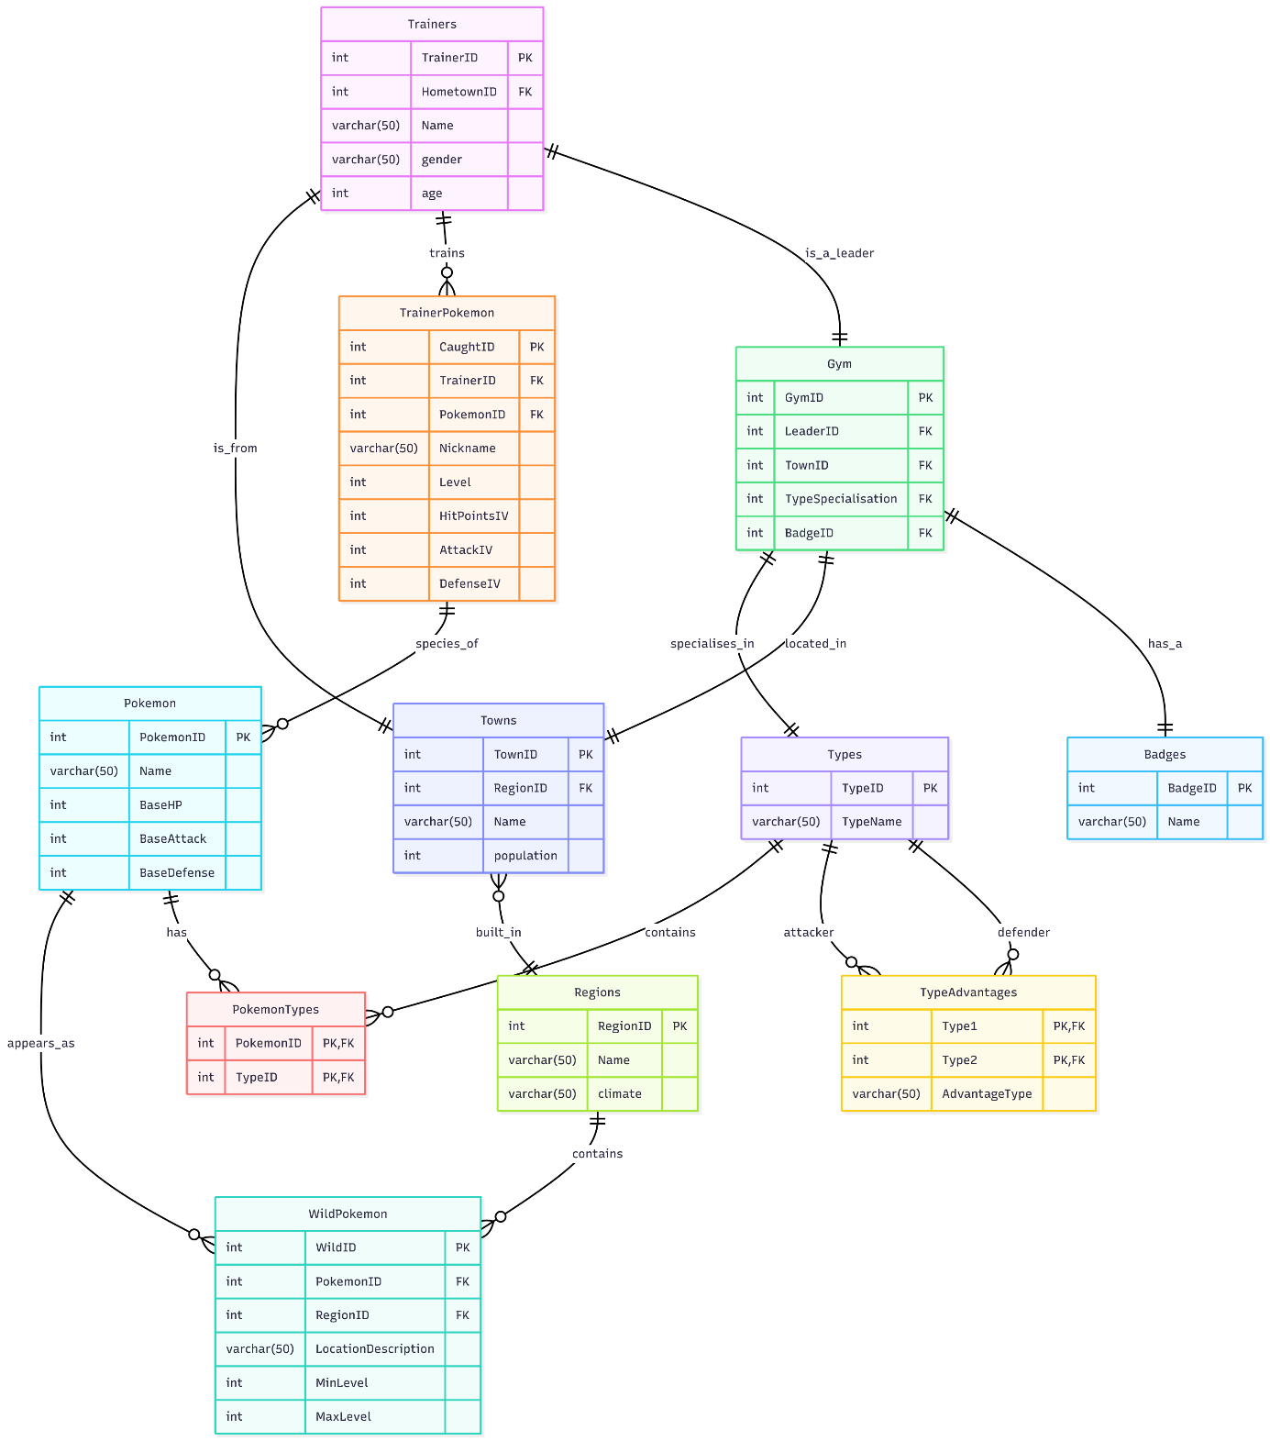
Entity Relationship Diagram (ERD)
Key Entities
Trainers – manage Pokémon, can lead gyms
Pokémon – stores species with base stats
TrainerPokemon – individual caught Pokémon with level & Iindividual Velues
Gyms – linked to leaders, located in towns, specialise in a type
Badges – awarded by gyms to trainers upon victory
Regions & Towns – geographical structure
Types & TypeAdvantages – used for battle logic
WildPokemon – available Pokémon in different regions
PokemonTypes – many-to-many relationship between Pokémon and types

Slide 4

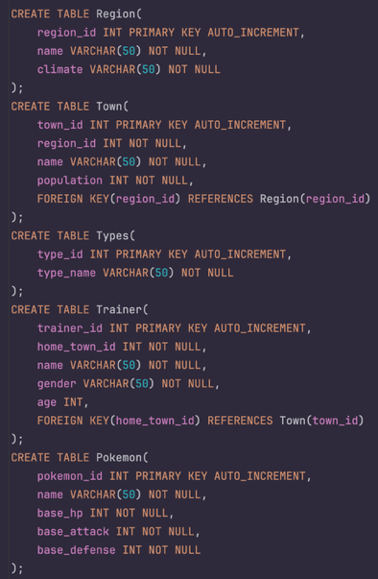
Normalisation & DataBase Schema
Normalisation
Tables designed up to 3rd Normal Form (3NF)
Removed repeating groups and duplicated data
Clear separation between Trainers, Pokémon, Gyms, Regions, Towns, Types etc.
Many-to-many handled via junction tables (TrainerPokemon, PokemonTypes)
Schema
PK and FK defined for all main tables
Constraints used to enforce data integrity
Logical structure based on ERD → converted into SQL CREATE TABLE statements

Slide 5
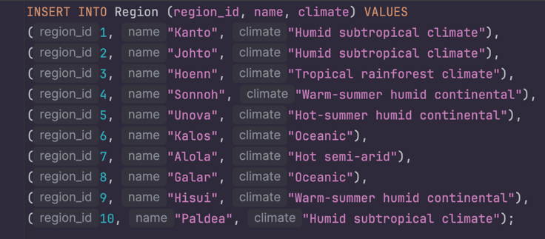
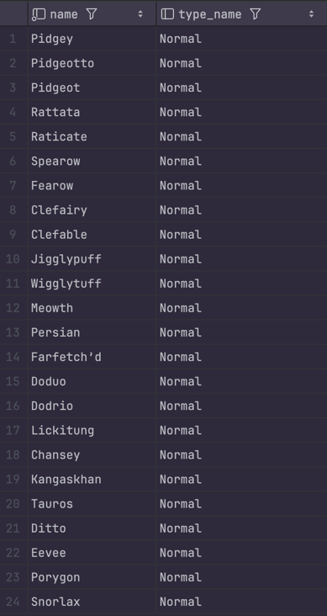
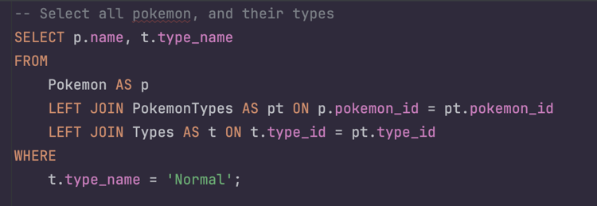
SQL CRUD Operations
INSERT example – test data added to the Region table
SELECT with JOIN – retrieves Pokémon and their types using table relationships
Read query validated – returned data confirms correct structure and table links
Demonstrates working Create and Read operations
Confirms successful data population and relationship integrity

Slide 6
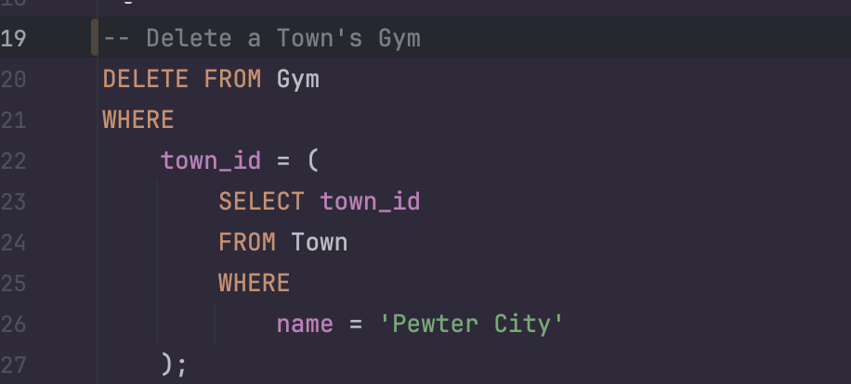
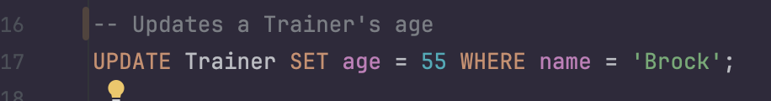
UPDATE & DELETE Operations
UPDATE example:
modifies trainer data (Brock’s age updated)
DELETE example:
removes a Gym using a subquery to identify the Town
Queries executed successfully and validated

Slide 7
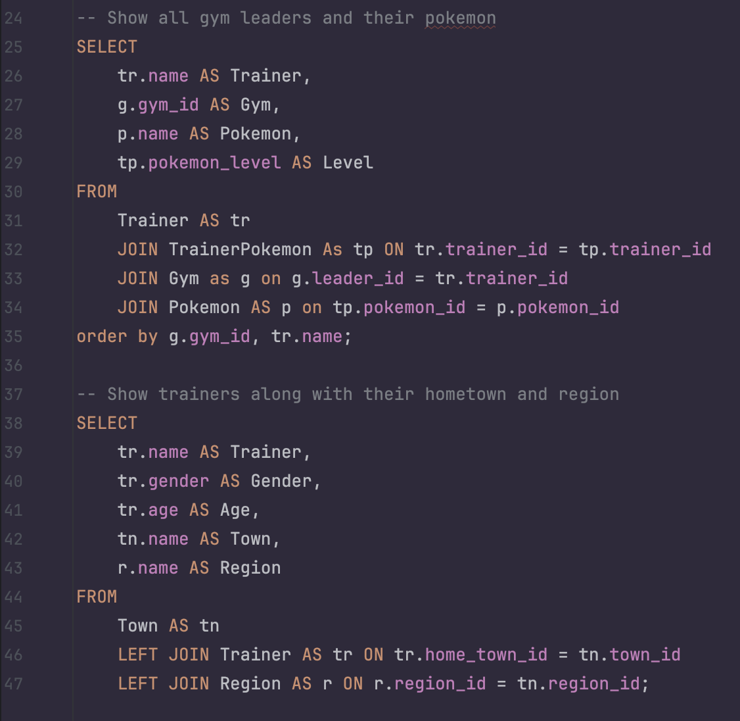
JOIN Queries
Combines data from multiple tables using inner and left joins
Query 1: Shows Gym Leaders and their Pokémon
Trainer → TrainerPokemon → Gym → Pokémon
Query 2: Displays trainers with hometown and region
Trainer → Town → Region
Demonstrates relational integrity and multi-table data analysis

Slide 8

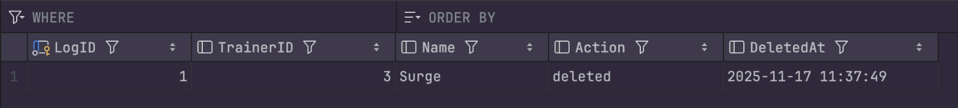
Triggers
after_trainer_delete logs deleted trainers into DeletedTrainers
delete_trainer_pokemon removes trainer’s Pokémon before delete
change_leader_if_deleted reassigned Gym Leader if needed
check_pokemon_level enforces level between 1–100
cap_max_iv caps Pokémon IVs at 31
✔ Automates enforcement of critical game rules ✔ Prevents orphan records and invalid inserts ✔ Improves consistency and reliability

Slide 9
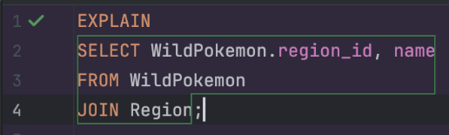

Indexes
Improves JOIN performance and reduces query execution time
Index for the region join
CREATE INDEX index_wildpokemon_region ON WildPokemon(region_id);
Index for the pokemon join
CREATE INDEX index_wildpokemon_pokemon ON WildPokemon(pokemon_id);
Index for PokemonTypes join (frequent joins between Pokemon and Types)
CREATE INDEX idx_pokemontypes_pokemon_id ON PokemonTypes(pokemon_id);
CREATE INDEX idx_pokemontypes_type_id ON PokemonTypes(type_id);

Slide 10

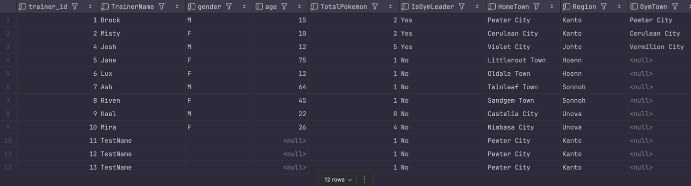
SQL Views
TrainerPokemonStats - Calculates real-time Pokémon stats based on base values, IVs and level
PokemonWithTypes - Combines multiple Pokémon types into one row using GROUP_CONCAT()
TrainerSummary - Shows trainer profile incl. total Pokémon, gym leadership, hometown and region
TrainerPokemonMaxLevelView - Displays each trainer’s highest-level Pokémon.
Why Views were used
Simplifies complex JOIN queries
Improves readability & reusability
Supports analysis and gameplay decisions
Helps generate trainer reports and Pokémon statistics instantly

Slide 11


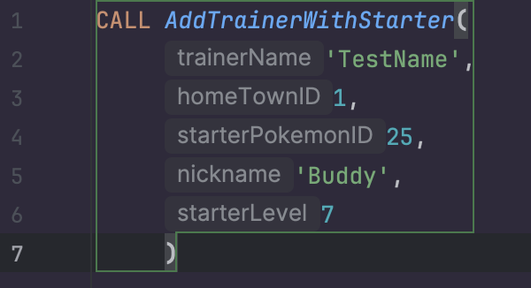


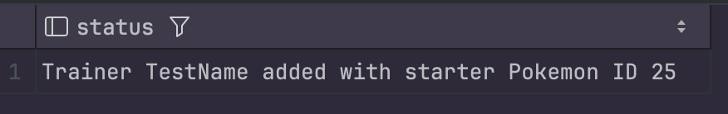

Stored Procedures
Stored procedures were created to automate common database operations and reduce the risk of manual errors.
AddPokemon – inserts a new Pokémon species and assigns it to a region and type
AddTrainerWithStarter – adds a new trainer and assigns a starter Pokémon with randomly generated IV stats.

Slide 12

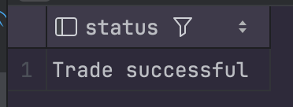
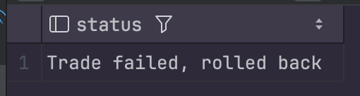
Transactions
TradePokemon – simulates a Pokémon trade between two trainers. If any part fails, the trade is cancelled and rolled back.
COMMIT if both updates succeed
ROLLBACK if any condition fails
BuyPokemon – allows a trainer to purchase a wild Pokémon. Ensures atomic execution (either fully succeeds or fails).
also uses transaction & rollback protection

Slide 13

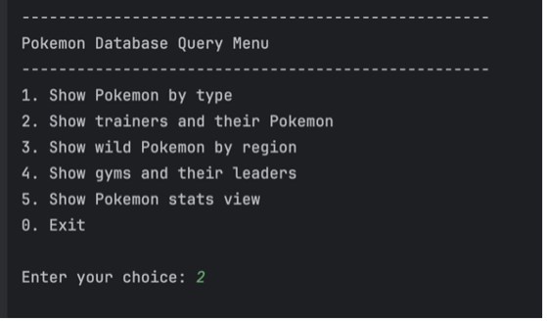
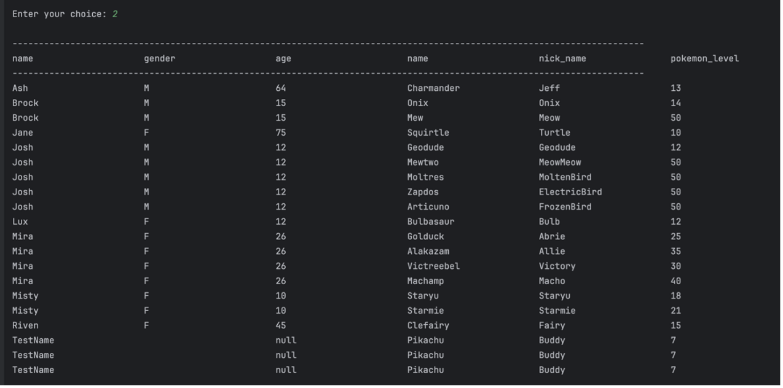
Java Database Connectivity
Java application connects to the MySQL database using JDBC
Queries are executed based on user menu selection (interactive console program)
Results are formatted into readable tables and displayed row-by-row
Demonstrates secure connection, query handling, and integration between backend (Java) and database (MySQL)

Slide 14
Thank You!

